Slide 1
Measuring Length and Area
Geometry
Chapter 11
Notes:
Geometry 11

Slide 2
This Slideshow was developed to accompany the textbook
Larson Geometry
By Larson, R., Boswell, L., Kanold, T. D., & Stiff, L.
2011 Holt McDougal
Some examples and diagrams are taken from the textbook.
Slides created by
Richard Wright, Andrews Academy
rwright@andrews.edu

Slide 3
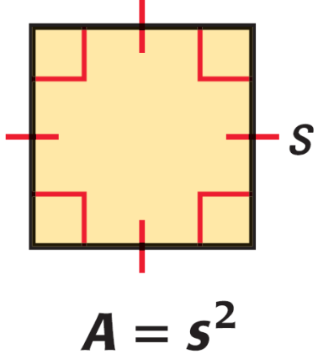
11.1 Areas of Triangles and Parallelograms
Area of a Square
$$A=s^{2}$$
Where s is the length of a side.
Area Congruence Postulate
If 2 polygons are congruent, then they have the same area.
Area Addition Postulate
The total area is the sum of the areas of the nonoverlapping parts.

Slide 4
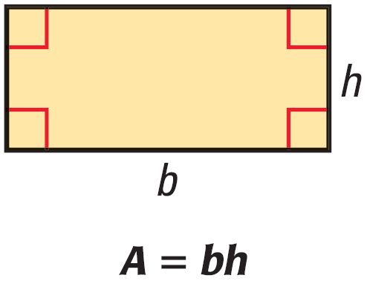
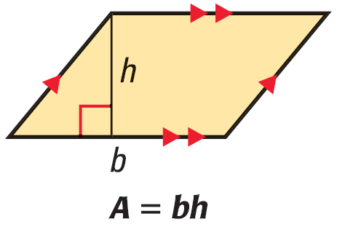
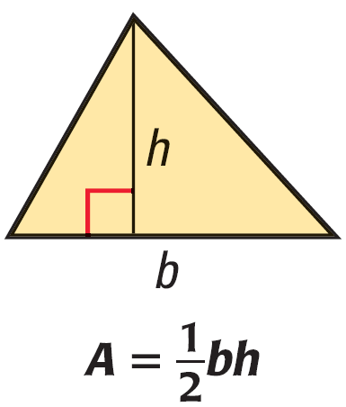
11.1 Areas of Triangles and Parallelograms
Area of a Rectangle
$$A=bh$$
Where b is the base and h is the height.
Area of a Parallelogram
$$A=bh$$
Where b is the base and h is the height.
Area of a Triangle
$$A=\frac{1}{2}bh$$
Where b is the base and h is the height.
Notes:
Rectangle can be divided into b by h unit squares.
Parallelogram can be cut apart and built into a rectangle.
Triangle is ½ a parallelogram.

Slide 5
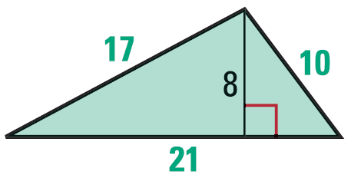
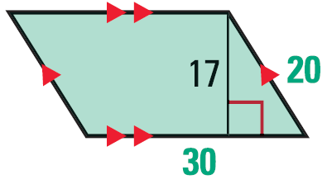
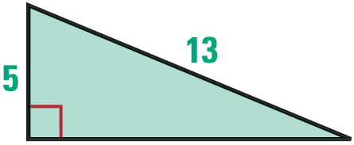
11.1 Areas of Triangles and Parallelograms
Find the perimeter and area of the polygon.
Notes:
$$P=17+10+21=48$$
$$A=\frac{1}{2}\left(21\right)\left(8\right)=84$$
$$P=20+30+20+30=100$$
$$A=30\left(20\right)=600$$
$$a^{2}+b^{2}=c^{2}$$
$$5^{2}+b^{2}={13}^{2}$$
$$25+b^{2}=169$$
$$b^{2}=144$$
$$b=12$$
$$P=5+12+13=30$$
$$A=\frac{1}{2}\left(5\right)\left(12\right)=30$$

Slide 6
11.1 Areas of Triangles and Parallelograms
A parallelogram has an area of 153 in² and a height of 17 in. What is the length of the base?
Find the area.
723 #4-40 even, 48-54 even = 23
6
7
3
12
Notes:
$$A=bh$$
$$153=b17$$
$$b=9$$
Length of right rectangle is 6
$$A=7\left(6\right)+3\left(6\right)=60$$

Slide 7
Answers and Quiz
11.1 Answers
11.1 Homework Quiz

Slide 8
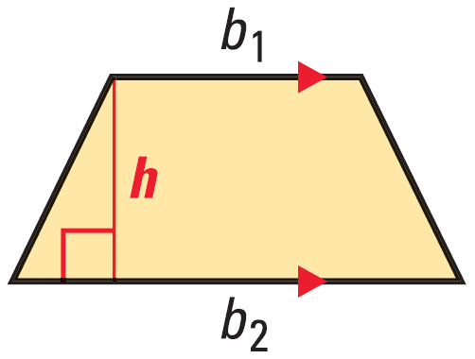
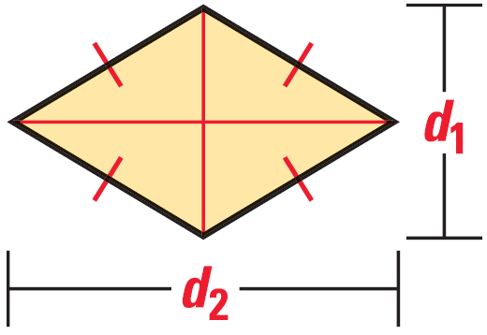
11.2 Areas of Trapezoids, Rhombuses, and Kites
Area of a Trapezoid
$$A=\frac{1}{2}h\left(b_{1}+b_{2}\right)$$
Where h is the height and b₁ and b₂ are the bases.
Area of a Rhombus
$$A=\frac{1}{2}d_{1}d_{2}$$
Where d₁ and d₂ are the diagonals.
Notes:
Trapezoid is a triangle + parallelogram
$$A=\frac{1}{2}(b_{2}−b_{1})h+b_{1}h$$
$$A=\frac{1}{2}b_{2}h−\frac{1}{2}b_{1}h+b_{1}h$$
$$A=\frac{1}{2}b_{2}h+\frac{1}{2}b_{1}h$$
$$A=\frac{1}{2}h\left(b_{1}+b_{2}\right)$$
Rhombus is four small triangles
$$A=4\left(\frac{1}{2}\left(\frac{1}{2}d_{1}\right)\left(\frac{1}{2}d_{2}\right)\right)$$
$$A=\frac{4}{8}d_{1}d_{2}$$
$$A=\frac{1}{2}d_{1}d_{2}$$

Slide 9
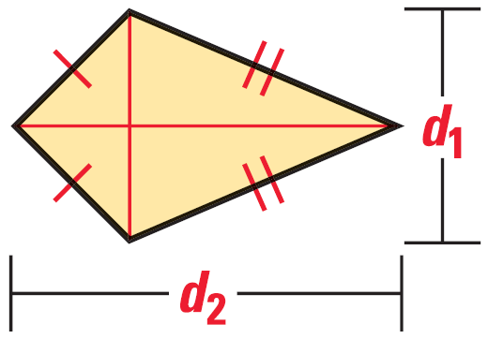
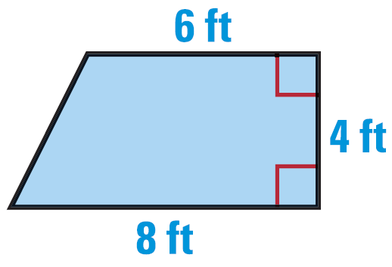
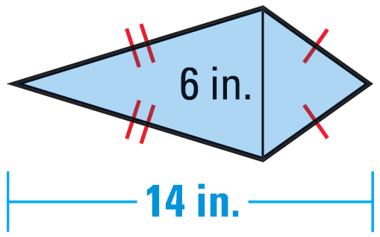
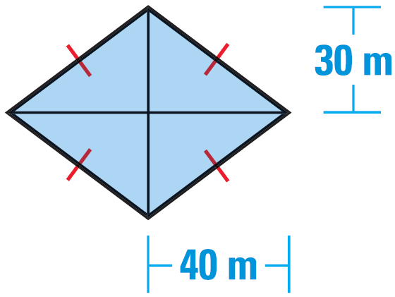
11.2 Areas of Trapezoids, Rhombuses, and Kites
Area of a Kite
$$A=\frac{1}{2}d_{1}d_{2}$$
Where d₁ and d₂ are the diagonals.
Find the area
Notes:
A Kite is two triangles with base d₂ and height ½ d₁
$$A=2\left(\frac{1}{2}\left(d_{2}\right)\left(\frac{1}{2}d_{1}\right)\right)$$
$$A=\frac{2}{4}d_{1}d_{2}$$
$$A=\frac{1}{2}d_{1}d_{2}$$
Trapezoid
$$A=\frac{1}{2}4\left(6+8\right)=28$$
Kite
$$A=\frac{1}{2}\left(6\right)\left(14\right)=42$$
Rhombus
$$A=\frac{1}{2}\left(80\right)\left(60\right)=2400$$

Slide 10
11.2 Areas of Trapezoids, Rhombuses, and Kites
The area of a kite is 80 ft². One diagonal is 4 times as long as the other. Find the diagonal lengths.
Find the area of a rhombus with vertices M(1, 3), N(5, 5), P(9, 3) and Q(5, 1).
733 #4-38 even, 44-48 even = 21
Notes:
Kite
$$A=\frac{1}{2}d_{1}d_{2}$$
$$d_{1}=4d_{2}$$
$$80=\frac{1}{2}4d_{2}\left(d_{2}\right)$$
$$80=2d_{2}^{2}$$
$$40={\left(d_{2}\right)}^{2}$$
$$d_{2}=2\sqrt{10}$$
$$d_{1}=8\sqrt{10}$$
Rhombus
Diagonals are $d_{1}=8, d_{2}=4$
$$A=\frac{1}{2}\left(8\right)\left(4\right)=16$$

Slide 11
Answers and Quiz
11.2 Answers
11.2 Homework Quiz

Slide 12
11.3 Perimeter and Area of Similar Figures
What is the perimeter and area of a square that is 1 unit per side?
Triple the sides; what is the perimeter and area of a square that is 3 units per side?
What is the ratio of perimeters?
What is the ratio of areas?
Notes:
P = 4; A = 1
P = 12; A = 9
12/4 = 3
9/1 = 9 = 3²

Slide 13
11.3 Perimeter and Area of Similar Figures
Areas of Similar Polygons
If two polygons are similar with lengths in ratio of $\frac{a}{b}$ , then the areas are in ratio of $\frac{a^{2}}{b^{2}}$.
The perimeter of ΔABC is 16 ft, and its area is 64 ft². The perimeter of ΔDEF is 12 ft. Given that ΔABC ~ ΔDEF, find the ratio of the area of ΔABC to the area of ΔDEF.
Find the area of ΔDEF.
Notes:
Lengths $\frac{16}{12}$
Areas $\frac{{16}^{2}}{{12}^{2}}=\frac{256}{144}=\frac{16}{9}$
Area of ΔDEF
$$\frac{16}{9}=\frac{64}{A}$$
$$16A=576$$
$$A=36$$

Slide 14
11.3 Perimeter and Area of Similar Figures
The ratio of the areas of two regular decagons is 20:36. What is the ratio of their corresponding side lengths in simplest radical form?
Notes:
Lengths $\frac{a}{b}$
Areas $\frac{a^{2}}{b^{2}}$
$$areas=\frac{20}{36}$$
$$lengths=\frac{\sqrt{20}}{\sqrt{36}}=\frac{2\sqrt{5}}{6}$$

Slide 15
11.3 Perimeter and Area of Similar Figures
Rectangles I and II are similar. The perimeter of Rectangle I is 66 inches. Rectangle II is 35 feet long and 20 feet wide. Show the steps you would use to find the ratio of the areas and then find the area of Rectangle I.
740 #2-28 even, 35-41 = 21
Extra Credit 743 #2, 4 = +2
Notes:
Convert 66 inches to feet
$$66in\left(\frac{1ft}{12in}\right)=5.5ft$$
Find perimeter of Rectangle II
$$P=35+35+20+20=110ft$$
Find ratio of perimeters
$$\frac{5.5}{110}=\frac{1}{20}$$
Find ratio of areas
$$\frac{1^{2}}{{20}^{2}}=\frac{1}{400}$$
Find the area of Rectangle II
$$35\left(20\right)=700ft^{2}$$
Use the ratio to find the area of Rectangle I
$$\frac{1}{400}=\frac{A}{700}$$
$$400A=700$$
$$A=\frac{7}{4}=1.75ft^{2}$$

Slide 16
Answers and Quiz
11.3 Answers
11.3 Homework Quiz

Slide 17
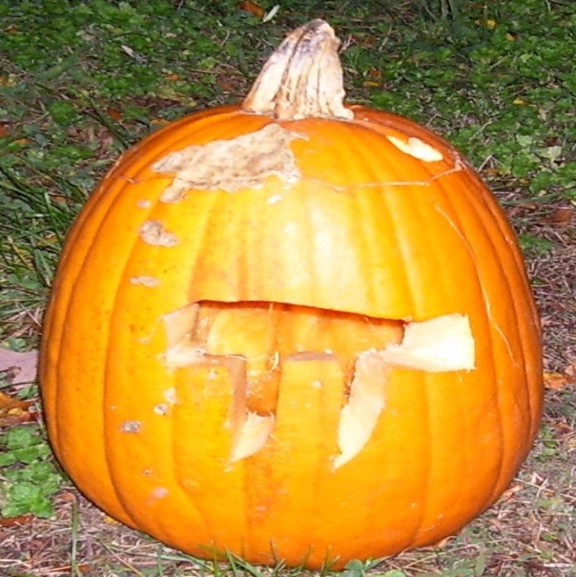
11.4 Circumference and Arc Length
Circumference of a Circle
Distance around the circle
Like perimeter
π
Ratio of the circumference to the diameter of a circle
Estimated in 2 Chronicles 4:2 and 1 Kings 7:23 as 3
3.141592654…
$$C=πd$$
$$C=2πr$$

Slide 18
11.4 Circumference and Arc Length
Find the circumference of a circle with diameter 5 inches.
Find the diameter of a circle with circumference 17 feet.
A car tire has a diameter of 28 inches. How many revolutions does the tire make while traveling 500 feet?
Notes:
$$C=πd$$
$$C=π5=15.7 in$$
$$17=πd$$
$$\frac{17}{π}=d$$
$$d=5.41 ft$$
$$28 in=2\frac{1}{3}ft$$
$$C=π\left(2\frac{1}{3}\right)=7.3304 ft$$
$$Revoultions=\frac{500}{7.3304}=68.2 rev$$

Slide 19
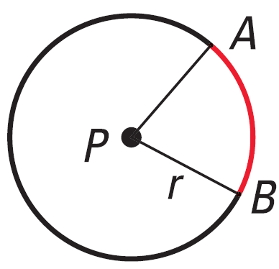
11.4 Circumference and Arc Length
Arc Length
Portion of the circumference that an arc covers
Arc Length
$$\text{Arc} \text{Length}=\frac{\text{Arc} \text{Measure}}{360°}⋅2πr$$
Notes:
$$Arc Length \overset{⏜}{AB}=\frac{m\overset{⏜}{AB}}{360°}⋅2πr$$

Slide 20
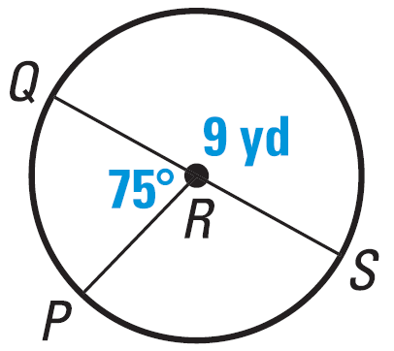
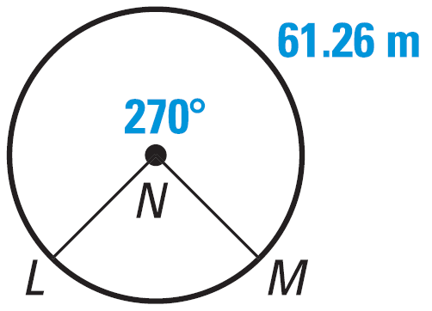
11.4 Circumference and Arc Length
Find the length of $\overset{⏜}{PQ}$.
Find the Circumference of $⨀N$.
Notes:
$$r=4.5 yd$$
$$Arc Length \overset{⏜}{PQ}=\frac{75}{360}⋅2π4.5 yd=5.89 yd$$
$$Arc Length =61.26 m$$
$$61.26 m=\frac{270}{360}⋅2πr$$
$$61.26 m=.75⋅2πr$$
$$81.7 m=2πr=C$$

Slide 21
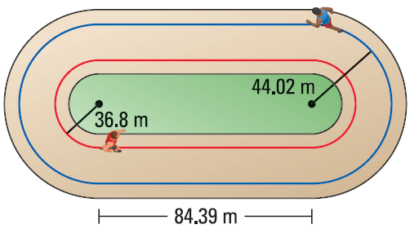
11.4 Circumference and Arc Length
How far does the runner on the blue path travel in one lap. Round to the nearest tenth of a meter.
749 #2-38 even, 42-48 even = 23
Notes:
The two ends make a circle
$$C=2π44.02 m=276.59 m$$
Add the two straight stretches
$$276.59 m+2\left(84.39 m\right)=445.4 m$$

Slide 22
Answers and Quiz
11.4 Answers
11.4 Homework Quiz

Slide 23
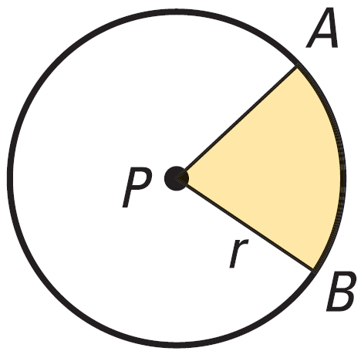
11.5 Areas of Circles and Sectors
Area of a Circle
$$A=πr^{2}$$
Sector of a Circle
Fraction of a Circle
Area of a Sector
$$A=\frac{\text{Arc} \text{Measure}}{360°}⋅πr^{2}$$

Slide 24
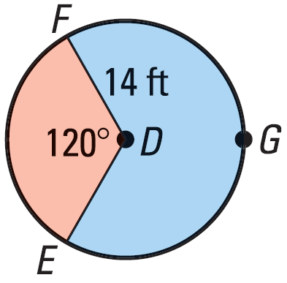
11.5 Areas of Circles and Sectors
Find area of $⨀D$
Find area of red sector
Find area of blue sector
Notes:
$$A=π{14}^{2}=615.8 ft^{2}$$
$$A=\frac{120}{360}π{14}^{2}=205.3 ft^{2}$$
$$A=\frac{240}{360}π{14}^{2}=410.5 ft^{2}$$

Slide 25
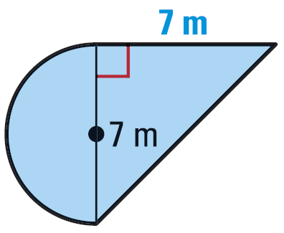
11.5 Areas of Circles and Sectors
Find the area of the figure.
758 #2-40 even, 46-50 even = 23
Extra Credit 761 #2, 6 = +2
Notes:
Semicircle
$$A=\frac{1}{2}\left(π{3.5}^{2}\right)=19.2423 m^{2}$$
Triangle
$$A=\frac{1}{2}\left(7\right)\left(7\right)=24.5 m^{2}$$
Total
$$19.2423 m^{2}+24.5{ m}^{2}=43.7 m^{2}$$

Slide 26
Answers and Quiz
11.5 Answers
11.5 Homework Quiz

Slide 27
11.6 Areas of Regular Polygons
Now that we know how to find the area of a triangle we can find the area of any polygon since it can be broken up into triangles.
For example find the area of a stop sign.
$A=\frac{1}{2}Pa$
a
s
Notes:
It has 8 sides, I’ll call them s.
If we draw lines connecting opposite vertices, we have 8 identical triangles.
Draw the altitudes from the center of the sign and call it a.
The area of each triangle is ½ sa.
The area of the sign then is 8(½ sa).
But the perimeter, P, is 8s, so the Area = ½ Pa.

Slide 28
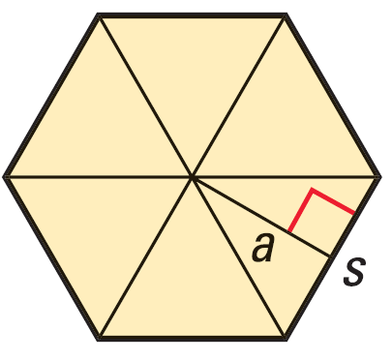
11.6 Areas of Regular Polygons
Apothem
A segment drawn from the center of a regular polygon perpendicular to the edge (also bisects edge)
Area of a Regular Polygon
$$A=\frac{1}{2}Pa$$
Where P is the perimeter and a is the apothem

Slide 29
11.6 Areas of Regular Polygons
Typical steps to find area of regular polygon
Find ½ of central angle
$\frac{1}{2}\left(\frac{360}{n}\right)$
Use trigonometry to find apothem
tan, sin, cos
$A=\frac{1}{2}Pa$
a
s

Slide 30
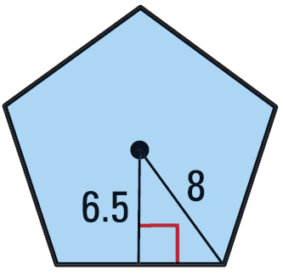
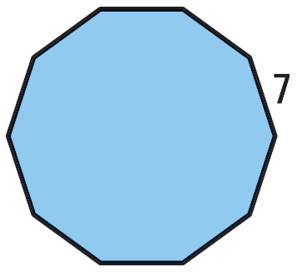
11.6 Areas of Regular Polygons
Find the area of the regular polygon.
Notes:
Pentagon
Pythagorean theorem to find side
$${6.5}^{2}+x^{2}=8^{2}$$
$$42.25+x^{2}=64$$
$$x^{2}=21.75$$
$$x=\frac{\sqrt{87}}{2}=4.6637$$
$$s=2x=9.3274$$
Area
$$A=\frac{1}{2}\left(9.3274⋅5\right)\left(6.5\right)=151.6$$
Decagon
Find ½ central angle
$$\frac{1}{2}\left(\frac{360}{10}\right)=18°$$
Find apothem
$$\tan{18°}=\frac{3.5}{a}$$
$$a⋅\tan{18°}=3.5$$
$$a=10.7719$$
Find area
$$A=\frac{1}{2}\left(7⋅10\right)\left(10.7719\right)=377.0$$

Slide 31
11.6 Areas of Regular Polygons
Find the area of the shaded region
765 #2-32 even, 36, 38, 47-52 all = 24
12
Notes:
Find the area of the hexagon and subtract the area of the triangle.
Hexagon:
$$\frac{1}{2}side=6$$
$$\frac{1}{2}central angle=\frac{1}{2}\left(\frac{360}{6}\right)=30$$
Apothem $\tan{30}=\frac{6}{a}$
$$a⋅\tan{30}=6$$
$$a=10.3923$$
Area $\frac{1}{2}\left(12⋅6\right)\left(10.3923\right)=374.1230$
Triangle: Find the length of the segment from the center to the vertex.
$$\sin{30}=\frac{6}{r}$$
$$r\sin{30}=6$$
$$r=12$$
Apothem $\sin{30}=\frac{a_{Δ}}{12}$
$$a_{Δ}=6$$
Side $\cos{30}=\frac{x}{12}$
$$x=10.3923$$
$$s=20.7846$$
Area $A=\frac{1}{2}\left(20.7846⋅3\right)\left(6\right)=187.0615$
Subtract the areas → 374.12 – 187.06 = 187.06

Slide 32
Answers and Quiz
11.6 Answers
11.6 Homework Quiz

Slide 33
11.7 Use Geometric Probability
Let’s say you are listening to a radio contest where you hear a song and call in and name it.
The song was supposed to be played between 12:00 and 1:00, but you can only listen from 12:20 to 1:00 because that is when you get out of class.
What is the probability that you will hear the song?
$$\text{Probability}=\frac{\text{Favorable} \text{Outcomes}}{\text{Total} \text{Outcomes}}$$
But we have basically a line (timeline), so Probability will be $\frac{40 min}{60 min}=\frac{2}{3}≈67\%$

Slide 34
11.7 Use Geometric Probability
Length Probability Postulate
If a point on AB is chosen at random and C is between A and B, then the probability that the point is on AC is (Length of AC)/(Length of AB).
$$P\left(AC\right)=\frac{AC}{AB}$$
A
C
B

Slide 35
11.7 Use Geometric Probability
Area Probability Postulate
If a point in region A is chosen at random, then the probability that the point is in region B, which is in the interior of region A, is (Area of region B) / (Area of region A)
$$P\left(B\right)=\frac{Area of B}{Area of A}$$
A
B

Slide 36
11.7 Use Geometric Probability
Joanna designed in a new dart game. A dart in section A earns 10 points; a dart in section B earns 5 points; a dart in section C earns 2 points. Find the probability of earning each score. Round to the nearest hundredth. (r_{A} = 2, r_{B} = 5, r_{C} = 10)
C
B
A
Notes:
Area of A = π2² = 12.566
Area of B = π5² – 12.566 = 65.974
Area of C = π10² – π52 = 235.619
Area of Board = π10² = 314.159
P(A) = 12.566/314.159 = .040 = 4%
P(B) = 65.974/314.159 = .21 = 21%
P(C) = 235.619/314.159 = .75 = 75%

Slide 37
11.7 Use Geometric Probability
774 #4-26 even, 30-38 even, 39-44 all = 23
Extra Credit 777 #2, 4 = +2

Slide 38
Answers and Quiz
11.7 Answers
11.7 Homework Quiz

Slide 39
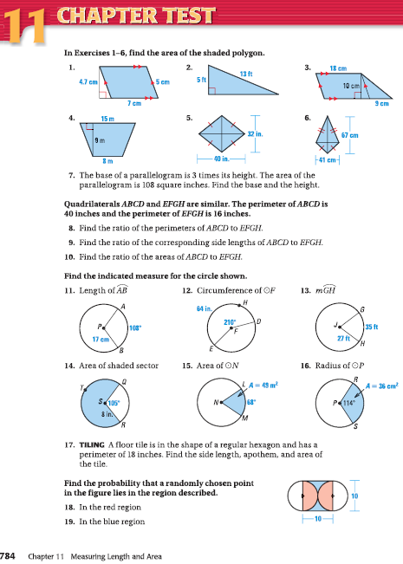
11.Review
784 #1-19 all = 19

